Slide 1
Energy Consumption and Prediction Project
P.Girija

Slide 2
Problem statement
Develop a predictive model to forecast the energy consumption of households based on historical power consumption data, conditions, and demographic information. The goal is to identify trends and help users optimize their energy usage
Data Importing
Reading Dataset
The file 'hpc.txt' is read with a semicolon (;) separator
hpc = household_power_consumption
Exploring the data by using head(),tail(),describe(),shape,info() to get idea about how the data is

Slide 3
Data Cleaning
Convert Date and Time to Datetime Format
Combined 'Date' and 'Time' columns to create a new 'Datetime' column
I combined date and time colums because Use time-based indexing to easily filter or retrieve data from a specific time range and Calculate time intervals between different records
Handled missing values:
The dataset consists of multiple columns, including both numerical and object
To get accurate Null values , first we have to convert columns which are in string to numericals
Columns that represent numerical values but stored as strings are converted using 'to_numeric'

Slide 4
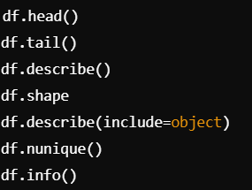
Feature Engineering:Created holiday and sunlight indicators.
Convert the tuple to a date object
Converting tuple (year, month, day) to date object
Apply the function to the 'Date' column (which is in (year, month, day) format)
Assuming 'time' is a tuple (hour, minute)
Sunlight is present between 06:00 and 18:00
Apply the function to the 'Time' column and create 'Sunlight' column
Checking data structures

Slide 5
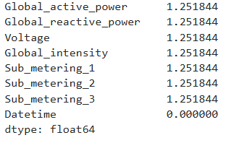
we can deal with null values by fill missing values with the mean , median of the column or delete row which have null values i am filled the mean of the column
the percentage of null values in each column

Slide 6

Mathematical Insight - Data Cleaning
Missing values percentage: (Missing Count/Total Rows)×100
Ensures unbiased results for linear models.
Filled using:

Slide 7
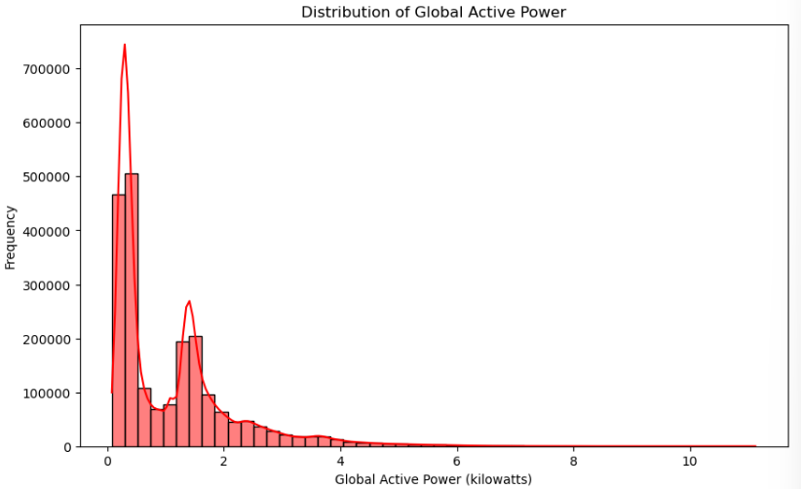
Data Visualization
What is the trend of 'Global_active_power' over time?
creates a histogram to show the distribution of "Global Active Power" in the dataset. It divides the data into 50 bins and adds
smooth curve on top to highlight the overall pattern. The plot is labeled with the title and axis descriptions, and it’s displayed on the screen.

Slide 8
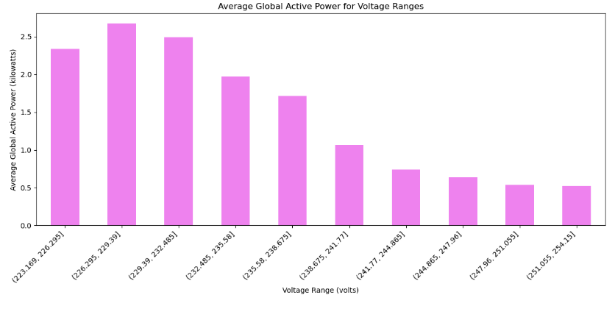
What is the relationship between 'Global_active_power' and 'Voltage’?
This groups the "Voltage" values into 10 equal ranges and calculates the average "Global Active Power" for each range. It then creates a barchart with the voltage ranges on the x-axis and the average power on the y-axis, displaying the relationship between voltage levels and power usage.

Slide 9
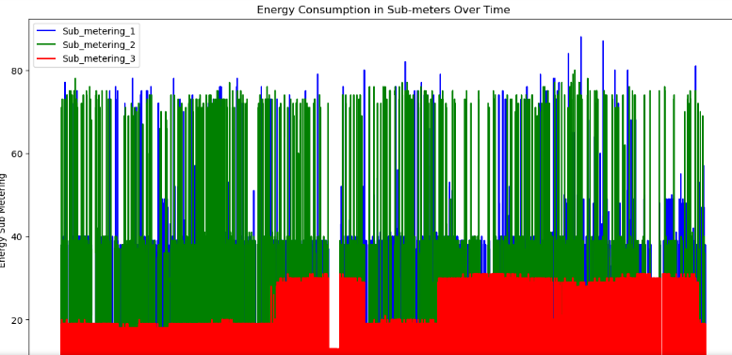
What is the daily average of 'Sub_metering' values?
This code creates a line plot to visualize the energy consumption from three sub-meters ('Sub_metering_1', 'Sub_metering_2', and 'Sub_metering_3') over time.
It plots each sub-meter's data against the Datetime column, with labels for each sub-meter and a legend to differentiate them
the energy consumption in the three sub-meters over time shows me clear trends and differences in how each sub-meter is used.

Slide 10
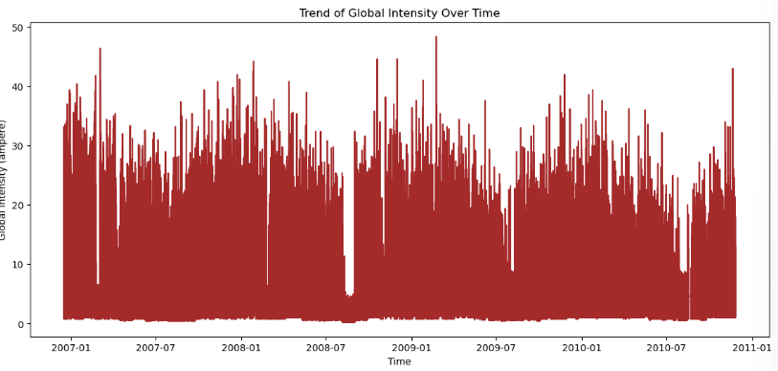

How does 'Global_intensity' vary over different hours of the day?
This code generates a line plot to display how "Global_intensity" changes over time. It uses the Datetime column for the x-axis and the "Global_intensity" for the y-axis, with the line colored purple.
Histogram: Distribution analysis through bins
.

Slide 11
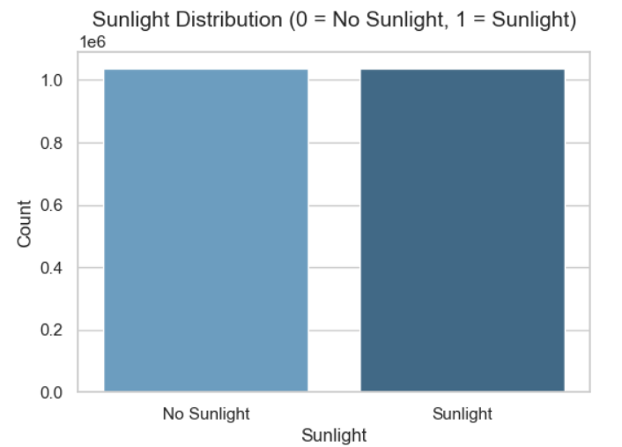
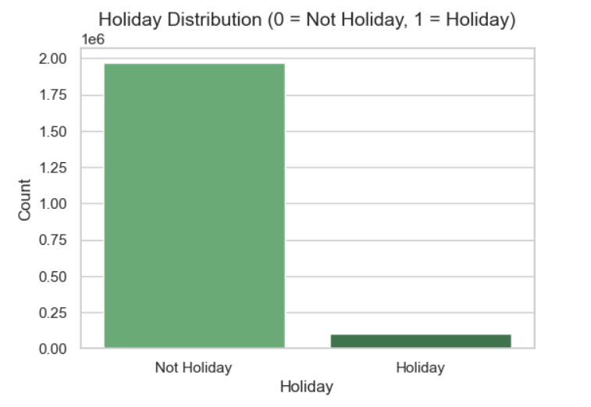
Bar charts for holiday and sunlight distributions
two bar plots: one for the distribution of sunlight (Sunlight column) and one for holidays (Holiday column).
Each plot shows the count of occurrences for values 0 and 1, where 0 means "No Sunlight"/"Not Holiday," and 1 means "Sunlight"/"Holiday."

Slide 12
Model Building
Feature Selection: Excluded time-based and categorical features, keeping only numerical variables for modeling.
Train-Test Split: Split the data into 80% training and 20% testing sets to evaluate model performance
Split the data into train and test sets
X_train, X_test, y_train, y_test = train_test_split(X, y, test_size=0.2, random_state=42)

Slide 13

Linear Regression
Linear Regression is a basic machine learning model used to predict a continuous outcome (dependent variable, y) based on one or more independent variables (X). The goal is to find a linear relationship between X and y by fitting a straight line to the data.
Model Initialization : LinearRegression() initialize the model
Model Training:fir(x_train,y_train) learns the best fit by minimizing the error between actual and predicted values
Prediction : predict(x_test) computes predictions using learned line
Evalution : RMSE , R^2

Slide 14

Lasso Regression
Lasso (Least Absolute Shrinkage and Selection Operator) is a type of linear regression that adds a penalty for large coefficients to reduce overfitting and perform feature selection. The penalty term ensures that some coefficients may shrink to exactly zero, effectively removing less important features.
Initialization: Lasso(alpha=0.1)adds regularization to reduce overfitting and select features.
Fit:lasso_model_fit(x_train,y_train) trains the model
Prediction:lasso_model_predict(x_test) makes predictions
Evaluation: RMSE evaluates error; R^2 measures explained variance.

Slide 15

Ridge Regression
Ridge Regression is a type of linear regression that includes a penalty term (regularization) to prevent overfitting by shrinking the regression coefficients. This is particularly useful when dealing with multicollinearity (correlated predictors) or high-dimensional data.
When α=0, Ridge Regression behaves like standard linear regression. A higher α\alphaα leads to more shrinkage of coefficients, reducing model complexity.
RMSE: Measures how well the model predictions match actual values (lower is better).
R²: Proportion of variance in the dependent variable explained by the model (closer to 1 is better)

Slide 16
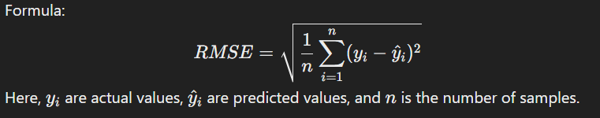
Data and Model Analysis
The purpose of this step is to assess the performance of the models used in predicting Global_active_power
This involves evaluating how well each model explains the variation in the target variable and how accurately it predicts unseen data. Additionally, we compare models to identify the one that balances simplicity and effectiveness.
Root Mean Square Error (RMSE):
RMSE is used to measure the average magnitude of the prediction errors
Lower RMSE indicates that model predictions are closer to actual values

Slide 17
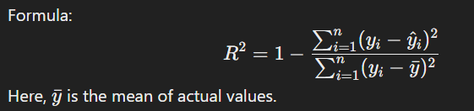
R² Score (Coefficient of Determination):
R² measures how much of the variance in the dependent variable is captured by the model
R² ranges from 0 to 1:1: Perfect prediction.
0: Model explains no variance.
Negative values indicate the model performs worse than a simple average.

Slide 18
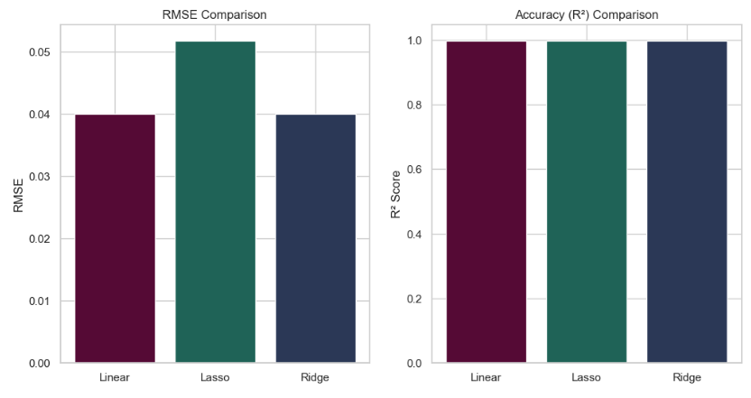
Observation:
In the RMSE plot, Ridge and Linear Regression show almost identical performance (RMSE: 0.04), indicating they fit the data well. Lasso has a slightly higher RMSE (0.05), likely due to its feature selection.
In the R² plot, all models have values close to 1.00, meaning they explain almost all the variance in the data. This suggests the data is well-suited for linear models.
Overall, Ridge and Linear Regression perform almost the same, while Lasso performs slightly worse due to its complexity reduction.

Slide 19
Why certain models have good accuracy and others don't
Linear Relationships in Data
The strong linear relationships allow Linear, Ridge, and Lasso models to capture patterns effectively with minimal complexity.
Regularization Impact
Ridge Regression: Stabilizes the model by penalizing large coefficients, slightly improving performance. Lasso Regression: Performs similarly, but with a marginally higher RMSE (0.05) due to its tendency to shrink some coefficients to zero.
Low Complexity and High Predictive Power
Low noise and high feature relevance allow these linear models to achieve high accuracy without needing complex non-linear approaches.

Slide 20
Data Forecasting
ARIMA :
An autoregressive integrated moving average, or ARIMA, is a statistical analysis model that uses time series data to either better understand the data set or to predict future trends.
ARIMA Model for Energy Consumption Forecasting
Aggregate daily energy consumption (Global_active_power).
Split data: 80% for training, 20% for testing.
Train ARIMA with parameters (p=2, d=1, q=2)
Use ARIMA to predict for the test period
Visualize training data, test data, and predictions to assess performance.

Slide 21
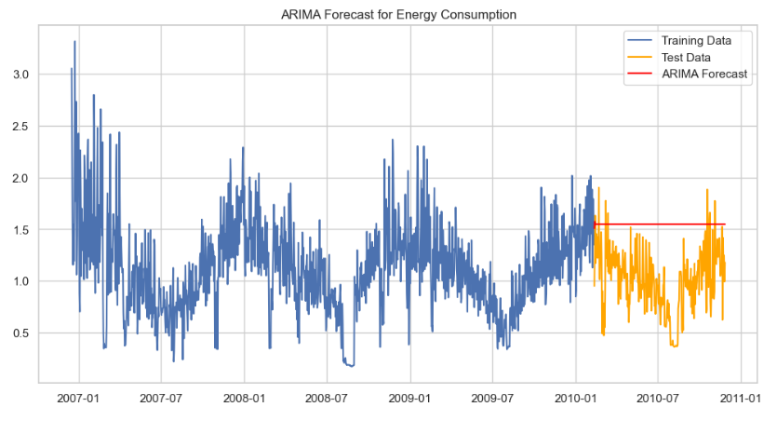
ARIMA works well for time series data that shows stationarity after differencing, and it captures patterns based on past values and errors.

Slide 22
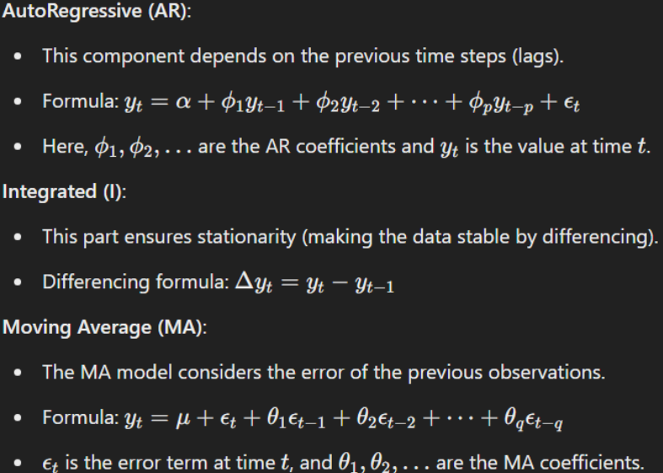
Math Behind ARIMA

Slide 23
Prophet
Prophet :
Prophet is an additive regression model that uses a piecewise linear or logistic growth curve trend to forecast data. It's designed to work best with time series that have strong seasonal effects and several seasons of historical data.
Energy Consumption Forecasting with Prophet
The dataset is reformatted for Prophet (ds for dates, y for values) and split into training (80%) and testing (20%).
A Prophet model is configured with yearly, weekly, and daily seasonality, then trained on the training data.
Forecasts are generated for 7 days (weekly), 30 days (monthly), and 365 days (yearly) into the future.

Slide 24
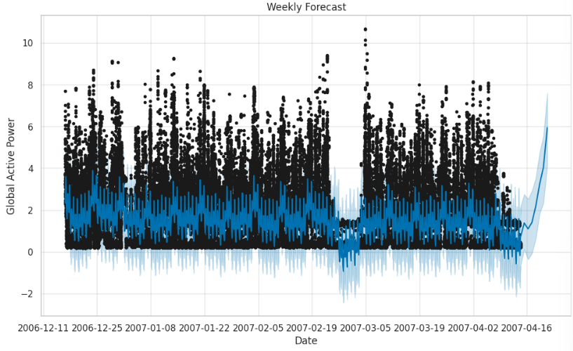
Weekly Forecast
Weekdays showed higher energy consumption compared to weekends due to typical household or industrial usage patterns.
Peak usage times within the week were accurately captured.

Slide 25
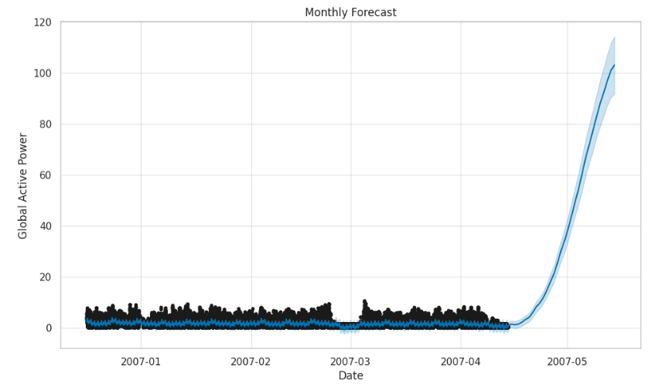
Monthly Forecast
The forecast captured recurring patterns such as slight dips in consumption on weekends and increased usage mid-month.
Monthly patterns often reflected cumulative effects of weather and social factors.

Slide 26
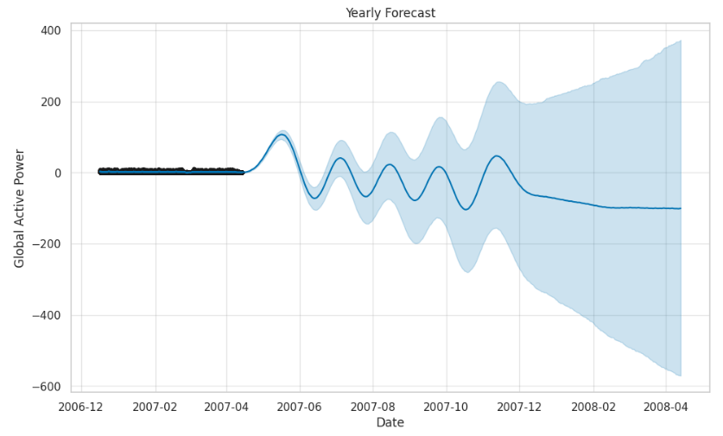
Yearly Forecast
Energy usage increased in colder months due to heating requirements and decreased in
warmer months.
Major holidays, such as festivals or public holidays, showed sharp dips or spikes depending
on the nature of energy use.

Slide 27
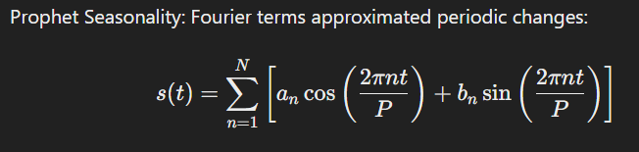
Trend: Indicates long-term growth or decline in energy consumption.
Seasonality:
Yearly: Captures recurring patterns over the years.
Daily: Reflects diurnal energy usage.
Patterns: Peaks during work hours, dips during off-hours.

Slide 28
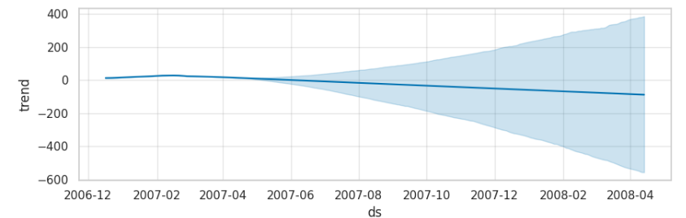
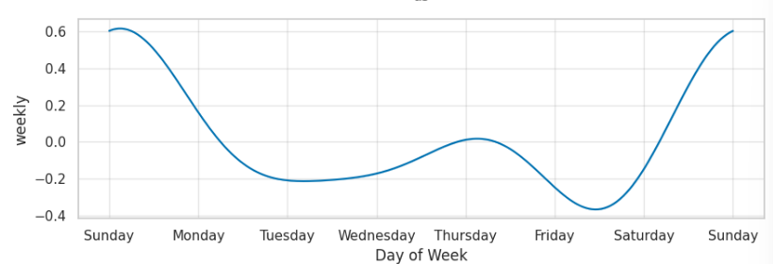
Time-Series Trends:
A gradual upward or downward trend indicates increasing or decreasing energy demands.
Seasonal dips or spikes may correlate with significant changes in weather, infrastructure, or population habits.
Higher usage observed on weekdays, often due to industrial or commercial activities
Lower energy consumption during weekends when residential activity dominates.c

Slide 29
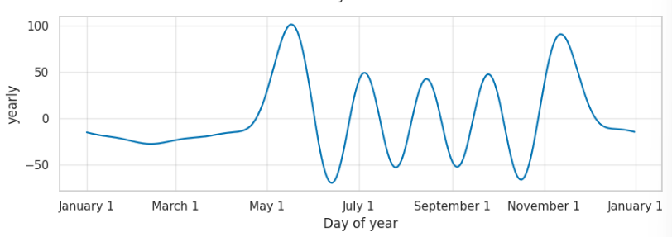
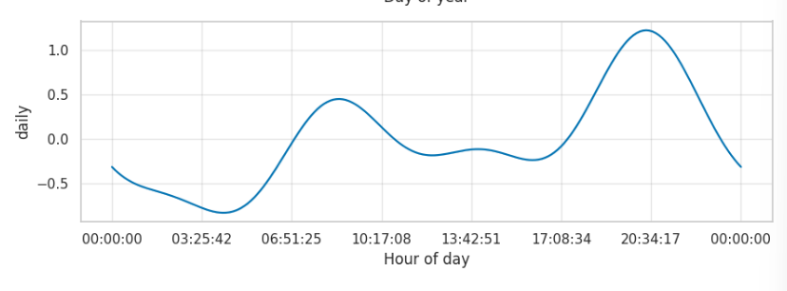
Peaks in winter months (higher heating needs) or summer months (air conditioning)
Significant dips during major holidays, such as national festivals or vacation periods.
Energy consumption gradually rises as people finish work and engage in home activities like cooking, lighting, and entertainment, peaking at 21:00.

Slide 30
Streamlit App
This script is a Streamlit-based web application designed to predict energy consumption using pre-trained
machine learning models. The application offers an interactive interface where users can inputfeatures like
voltage, global intensity, sub-metering values, and date-time throughsliders and pickers. It uses these inputs
to create a DataFrame that aligns with the models' expectedfeatures. The predictions are made using Linear
and Ridge Regression models, loaded viajoblib, and displayed dynamically with st.metric. The app also
incorporates custom styling, allowing users to select background colors and enjoy a visually appealing layout
with styled headers and input sections.

Slide 31
The application handles errors gracefully, ensuring a smooth user experience even if resources fail to load or predictions encounter issues. A disclaimer emphasizes the tool's purpose as an exploratory tool rather than one for critical energy management. By integrating robust functionality with a user-friendly interface, this script is an excellent example of how data science models can be deployed as web applications for real-world usability.

Slide 32
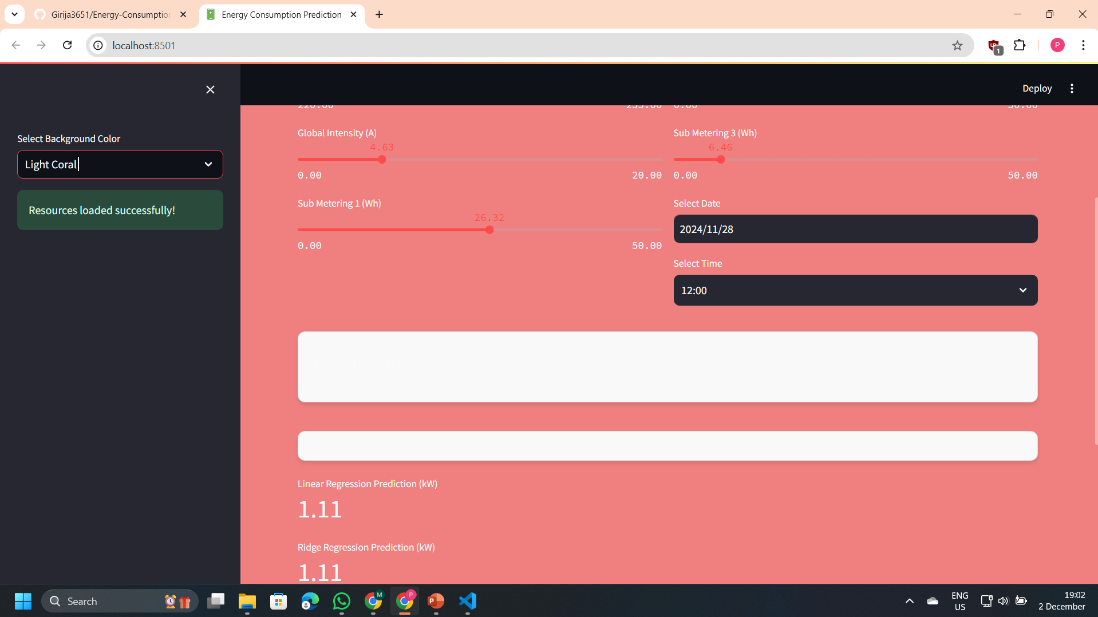
OUTPUT

Slide 33
Conclusion
In this analysis, we have successfully cleaned and visualized energy consumption data to uncover key insights about usage patterns. By exploring hourly, daily, and seasonal trends, we identified significant consumption peaks, particularly in the evening hours, and highlighted the influence of factors like sunlight and holidays. Through robust model building, including Linear, Lasso, and Ridge regression, we evaluated the accuracy of predictions using metrics like RMSE and R², with Ridge regression offering a stable performance under multicollinearity.
forecasting techniques like ARIMA and Prophet, which allowed us to predict future energy consumption trends across weekly, monthly, and yearly intervals, enhancing our understanding of long-term energy demand. These insights can guide better energy management, helping utilities optimize grid operations and improve demand-side management strategies

